Slide 1

User-preference Alignment based Fine-tuning
Sourish Dasgupta
Associate Professor, DAU, Gandhinagar
https://daiict.ac.in/faculty/sourish-dasgupta

Slide 2
Why not simply RL?

Slide 3
Where does RL-FT stop?
Limitation | Cause | What can happen
Single-reference loss – cross-entropy scores only one “gold” answer | Teacher-forcing treats any divergence from that answer as error, even if several answers are equally good | Repetition or generic answers; no reward for richer explanations
Length bias & brevity reward | Cross-entropy normalises by tokens, so shorter replies get less loss and dominate training | SFT models often produce terse, under-informative answers
Hard-coded style / tone | SFT bakes a fixed style that mirrors the dataset; changing tone means collecting new triples | Model can’t easily be made more formal, shorter, etc.
Limited long-horizon control | Token-level CE sees only one turn; multi-turn goals receive no direct signal ﻿ | Incoherent or contradictory multi-turn chats

Slide 4

Why Metric-based Reward may fail – Summarization Task

Slide 5
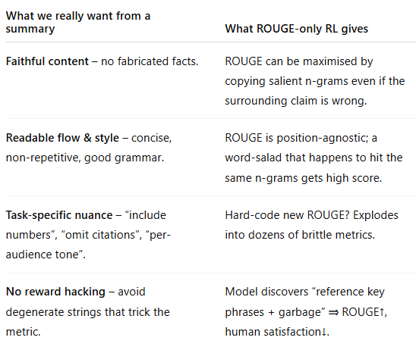
Why Metric-based Reward may fail – Summarization Task

Slide 6
Why Metric-based Reward may fail – Summarization Task

Slide 7
User Preference Alignment

Slide 8


Need a human-trained Reward Model

Slide 9
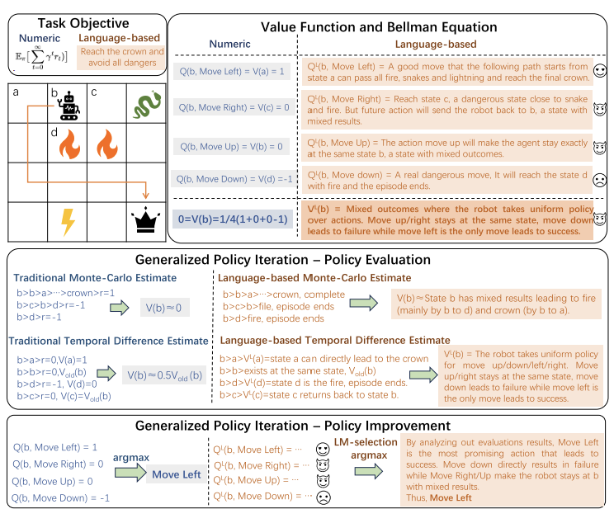


Everything else remains same

Slide 10
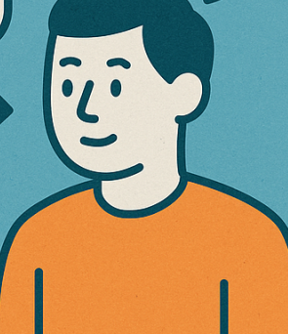
How will the human teach?
Summary A
Summary B
“Between summary A and summary B, which summary is better?”
“Give a rating to A and then give a rating to B?”
Vs.

Slide 11
Guessing the user’s preference

Slide 12





Chance that human will pick Summary 1?? → Bradley-Terry Model
Summary 1
Summary 2

Slide 13


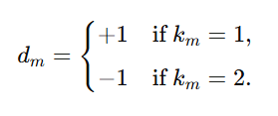
Chance that human will pick Summary 1 → Am I right?
-ve leading to +ve loss
Summary 1
Summary 2

Slide 14
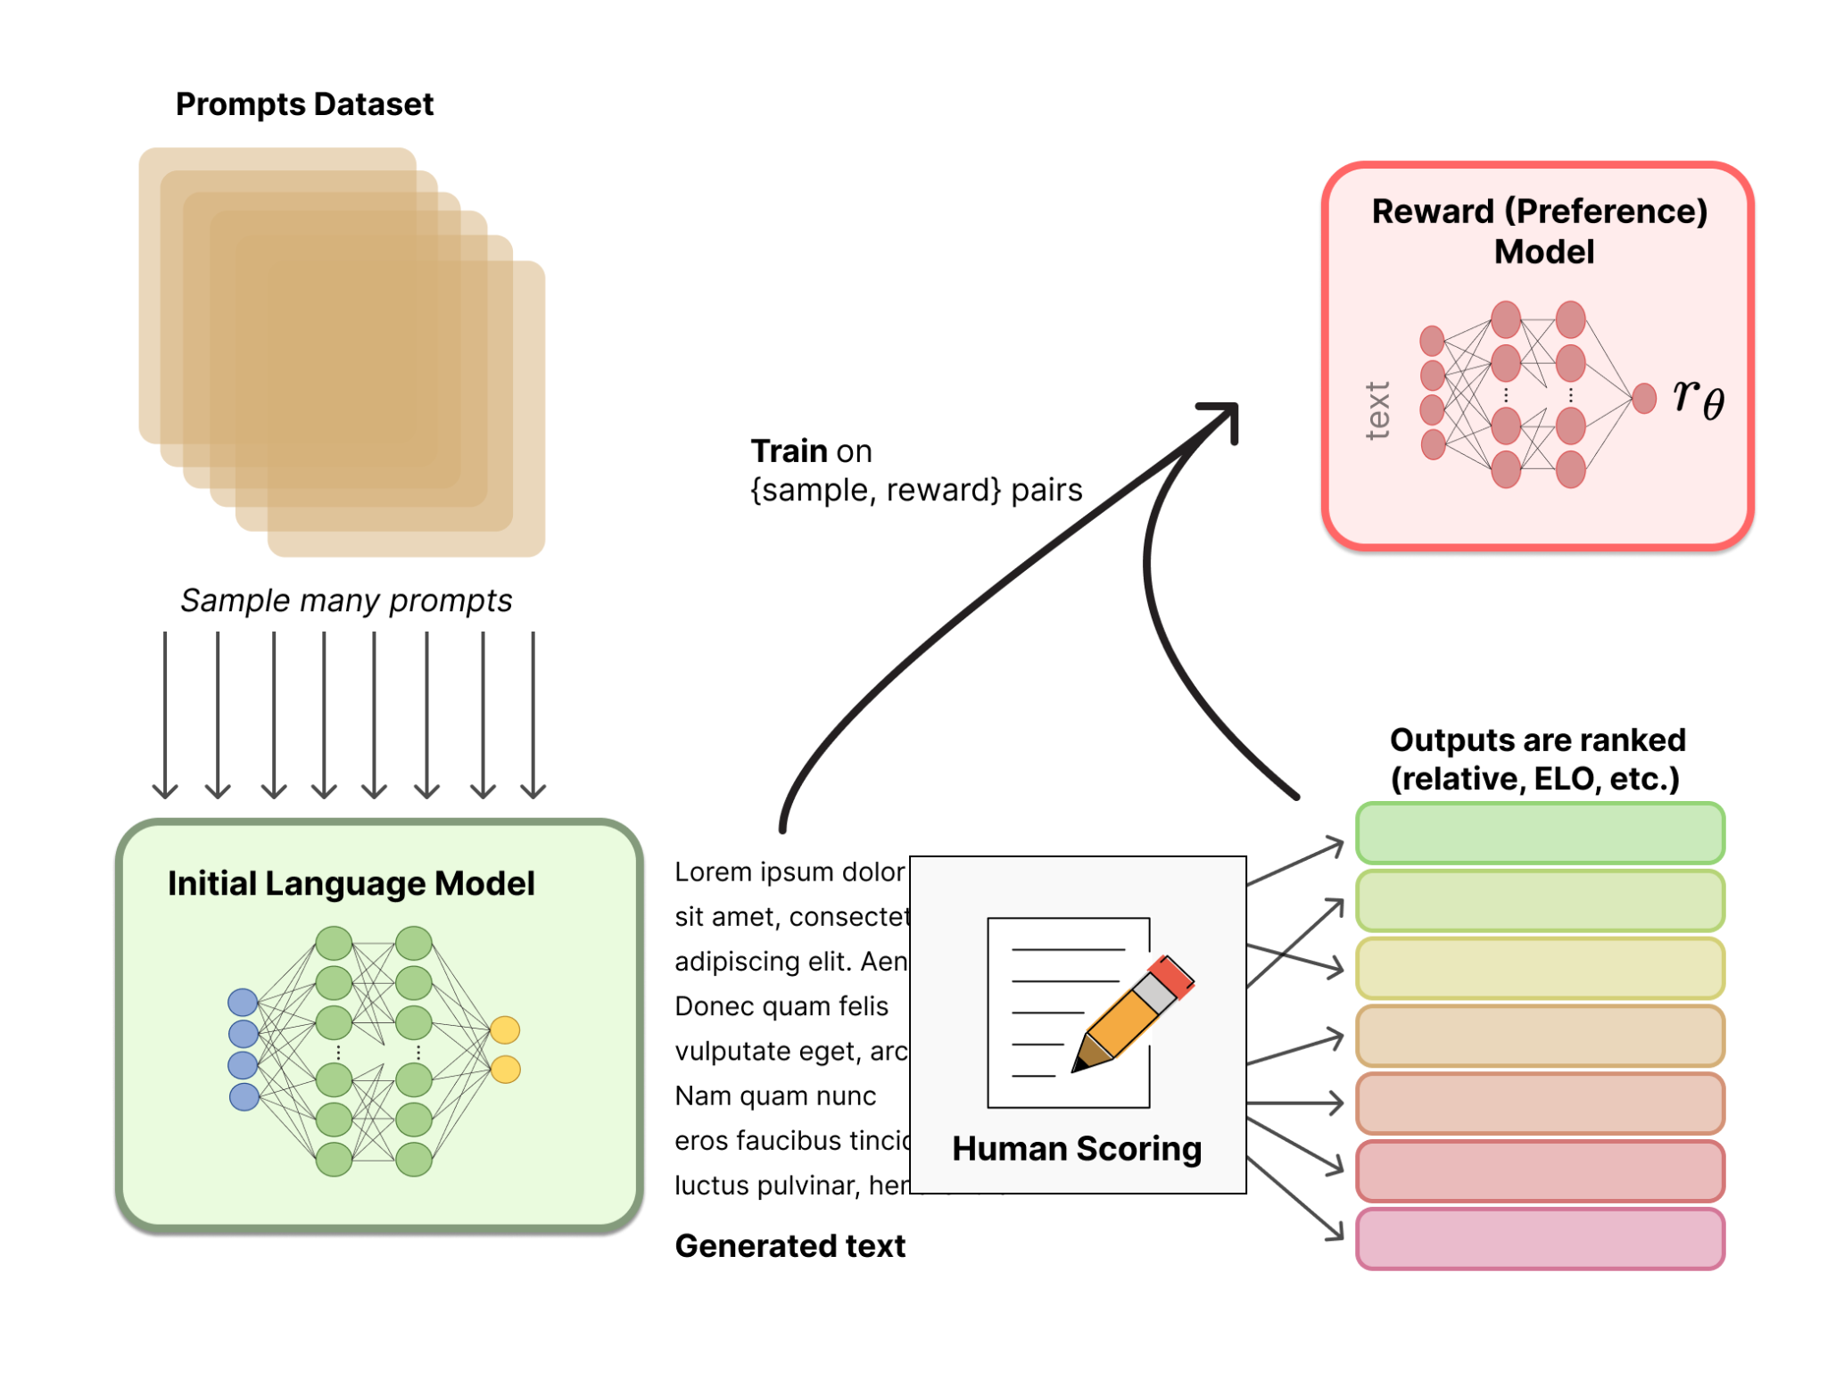
Phase 1: Create the Reward Model first (via Human Feedback) …

Slide 15
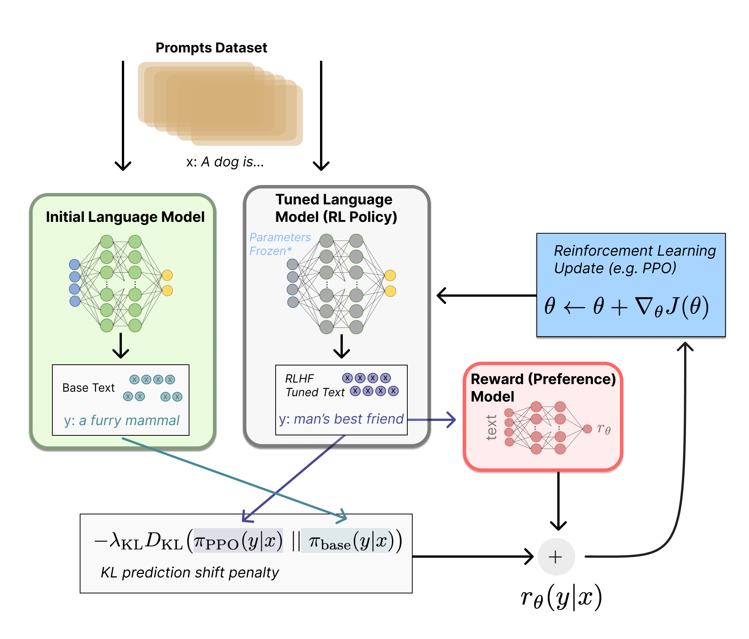
Phase 2: Do the RL-based FT (can be PPO-style) …

Slide 16
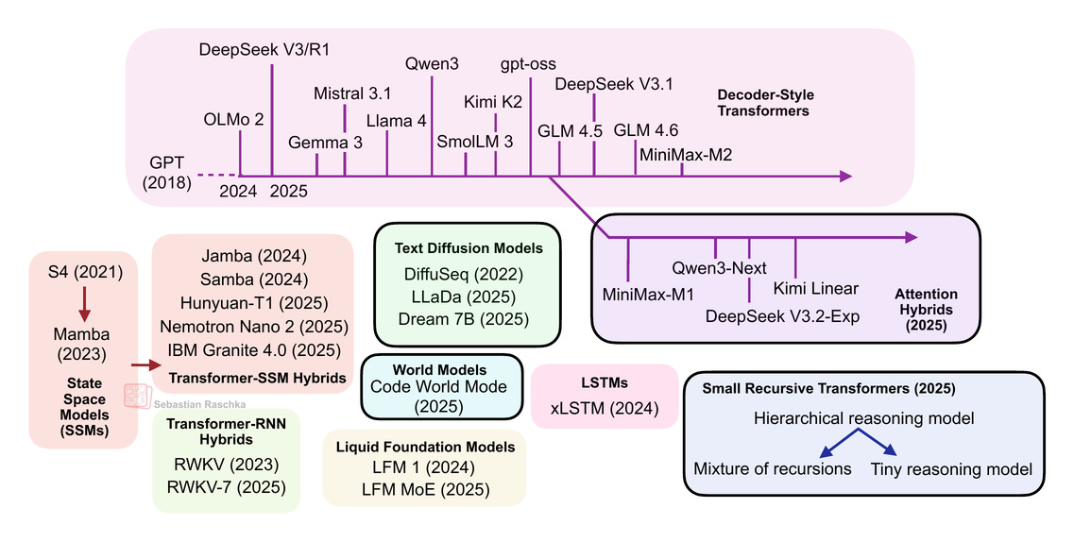
The current landscape – lot to learn!

